Slide 1
Week 5 Tutorial
Project risk analysis
Zirui Song
^{March 2025}

Slide 2
Agenda
3-2
3-4
3-5
3-7
3-12

Slide 3
Knowledge review 1: risk analysis
Uncertainty: what if…
Sensitivity analysis, Scenario analysis, Breakeven analysis
Phase 1: estimate what is expected to happen (NPV, IRR)
Phase 2: identify the investment’s value drivers

Slide 4
Knowledge review 1 (cont.)
Comparison Table: Sensitivity vs. Break-Even vs. Scenario Analysis
Concept | Purpose | Key questions | Excel tools | Group assignment
Sensitivity analysis | Examine how changes in one variable affect the outcome (e.g., value drivers) | “What happens to NPV if sales increase?” | Data table | Compulsory (4-6)
Breakeven analysis | Find the exact value of a variable where the outcome hits a threshold | “What sales leads to NPV=0?” | Goal seek | Recommended
Scenario analysis | Compares multiple variables changing together under different assumptions (e.g., best/worst) | “What if both cost increases and sales drop at the same time?” | Scenario manager | Compulsory (3-5)

Slide 5
Knowledge review 2: Excel functions
PV function in Excel
= PV (rate, nper, pmt, [fv], [type])
NPV function in Excel
= NPV (rate, value1, [value2])
Note: When calculating Net Present Value (NPV) in Excel, it's crucial to exclude the initial investment from the NPV function and add it separately.
IRR function in Excel
= IRR (values, [guess])

Slide 6
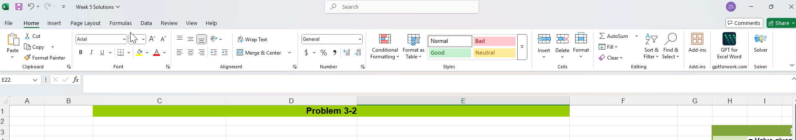
Knowledge review 2 (cont.)
Goal Seek: "What input value gives me the result I want?“

Slide 7
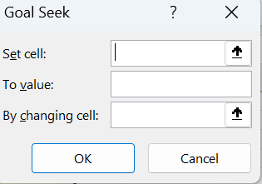
Knowledge review 2 (cont.)
where the formula is
the target you want
the real input value you want to solve for

Slide 8
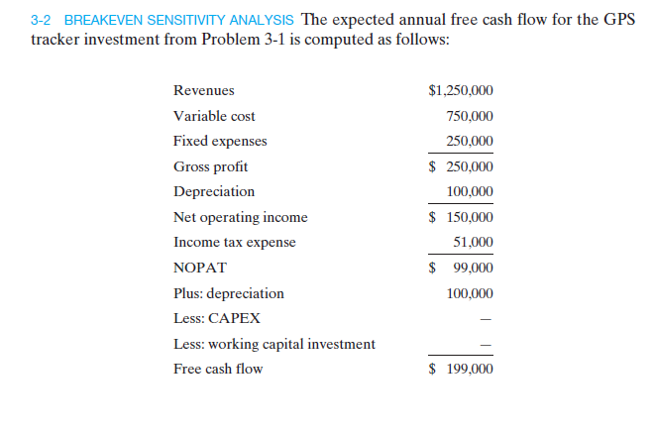
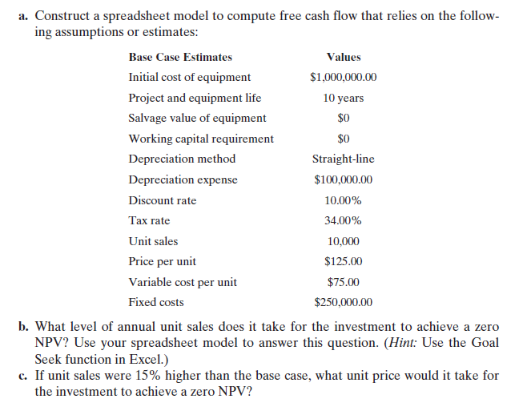
Problem 1

Slide 9

Problem 1 (cont.)
Answer
Excel demonstration in class
$Breakeven value of unit sales=8,901$
$Breakeven value of unit price=113.70$

Slide 10
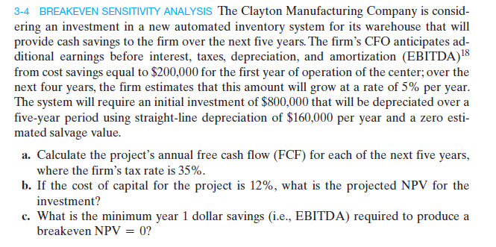
Problem 2

Slide 11
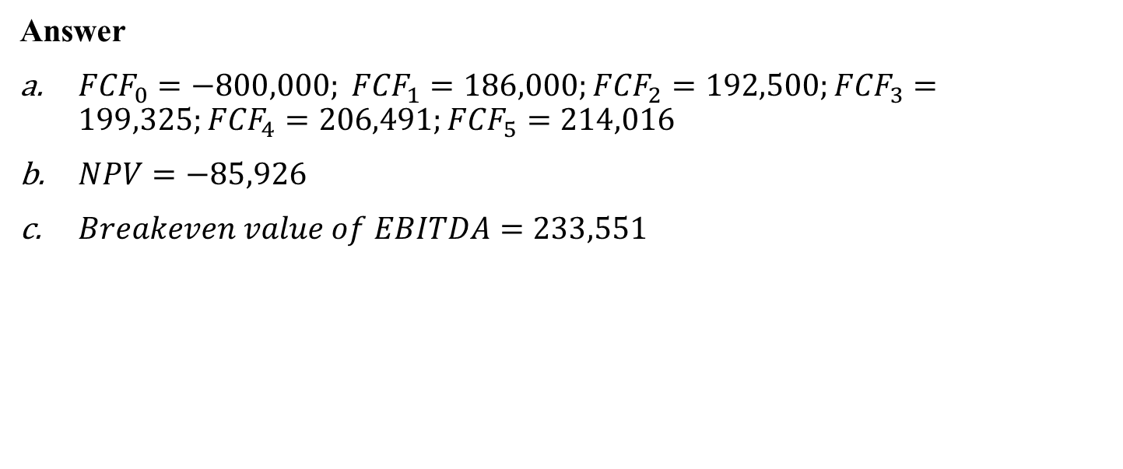
Problem 2 (cont.)
Answer
${FCF}_{0}=−800,000; {FCF}_{1}=186,000;{FCF}_{2}=192,500;{FCF}_{3}=199,325;{FCF}_{4}=206,491;{FCF}_{5}=214,016$
$NPV=−85,926$
$Breakeven value of EBITDA=233,551$

Slide 12
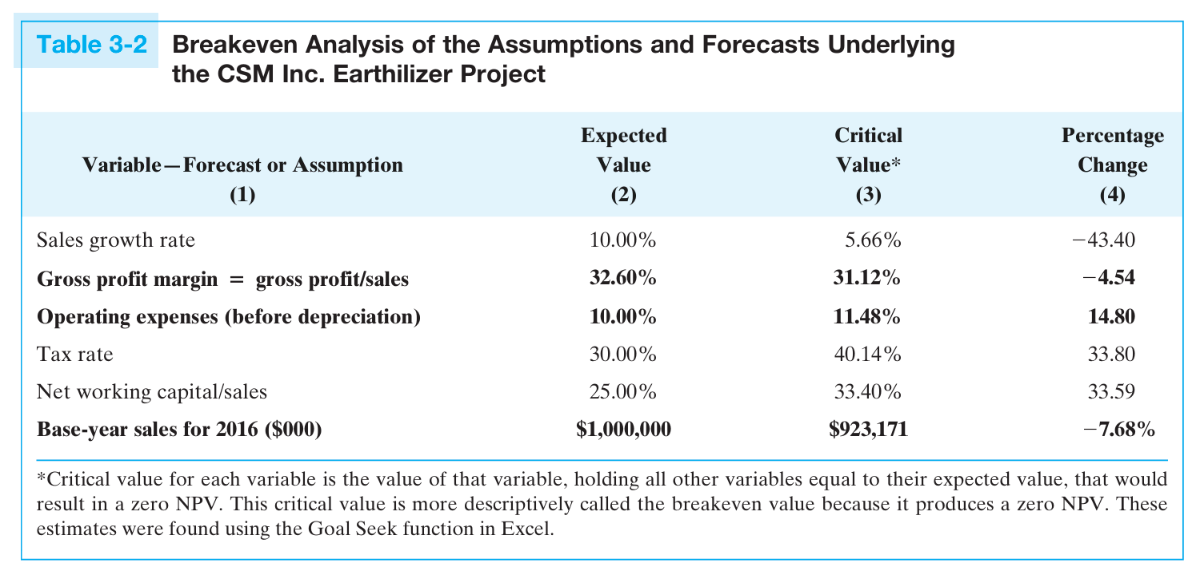

Knowledge review 3
$$\% Change=\frac{critical value}{expected value}−1$$
value drivers
Source: textbook, P61

Slide 13
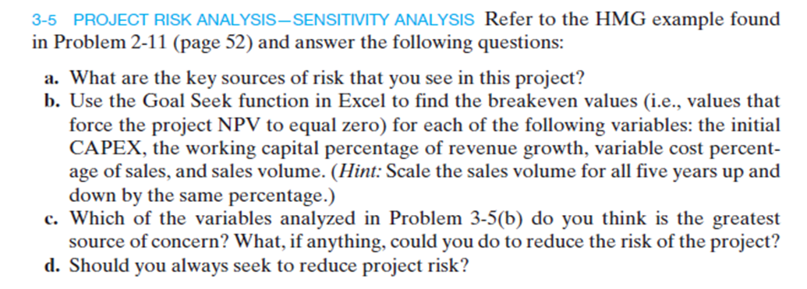
Problem 3

Slide 14
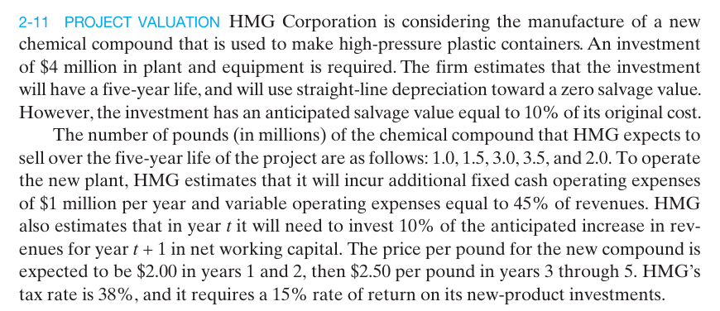
Problem 3 (cont.)

Slide 15
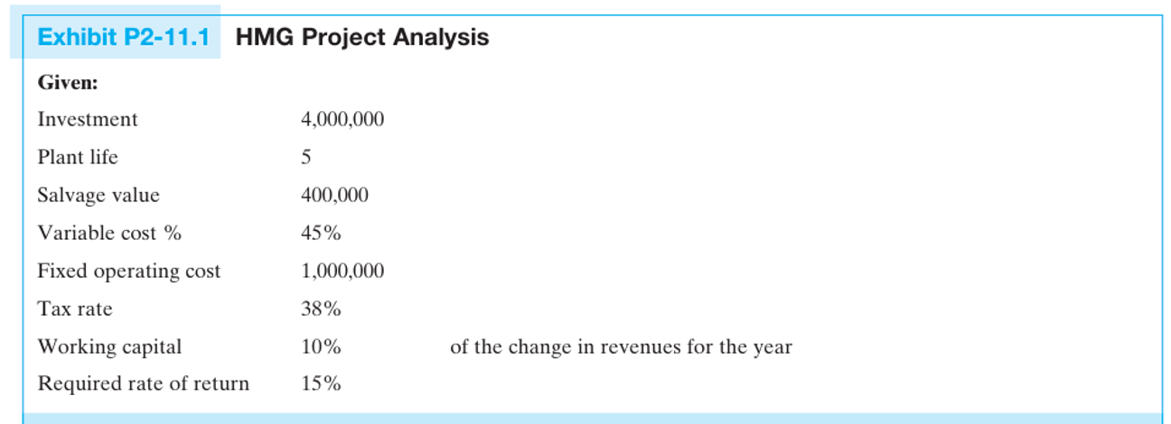
Problem 3 (cont.)

Slide 16
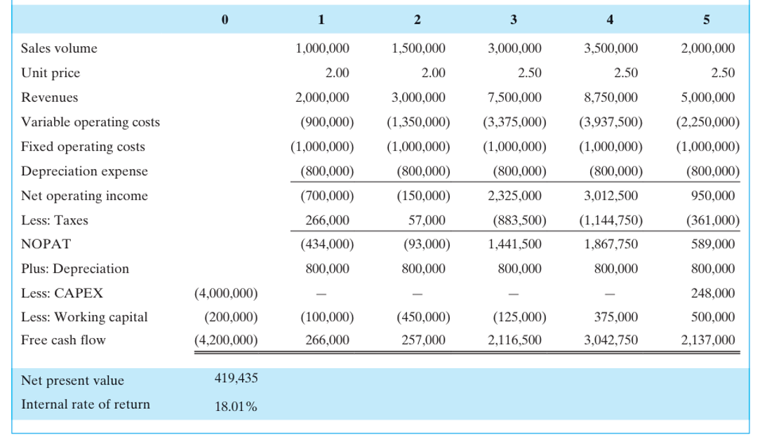
Problem 3 (cont.)

Slide 17
Problem 3 (cont.)
Answer
(1) The project’s sales forecast is risky, with a 100% jump from 1.5M to 3.0M units in year 3, which may be unrealistic. The sharp rise and later drop to 2.0M in year 5 signal demand uncertainty and potential overestimation of value. (2) This project is back-loaded, meaning most of its cash flows come in the later years (years 3–5), while the investment is front-loaded, with a $4.2M upfront cost. The timing mismatch between cost and return makes the project financially vulnerable in the early stages.
Excel demonstration in class

Slide 18
Problem 3 (cont.)
The initial capital cost, variable cost as a percent of sales and the sales volume are all roughly equally important in terms of their significance in driving the results of the investment. The kinds of things that can be done to control these costs entail careful cost contracting for the initial capital cost, and closely monitoring both the variable cost % and sales volume. It would also be helpful to know what "options" the firm might have with regard to reducing output or shutting down should the forecasts of sales volume or variable costs prove to be optimistic.
Not necessarily. While reducing risk is important, you should not always aim to eliminate it completely — especially if doing so reduces the project’s potential return.

Slide 19
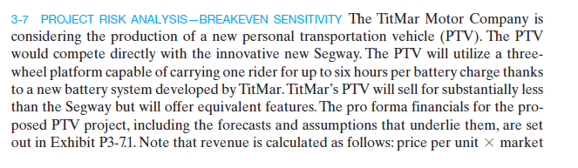
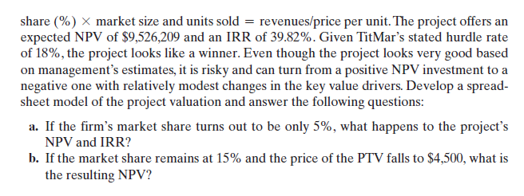
Problem 4

Slide 20
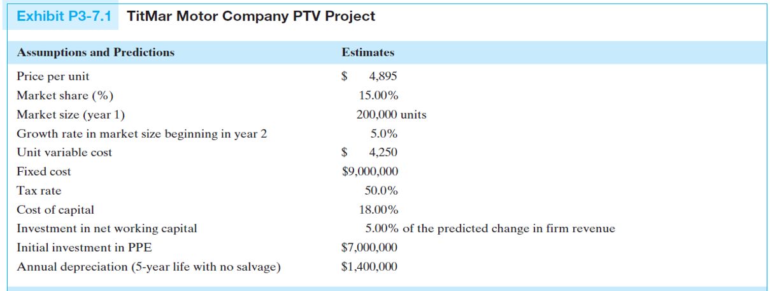
Problem 4 (cont.)

Slide 21
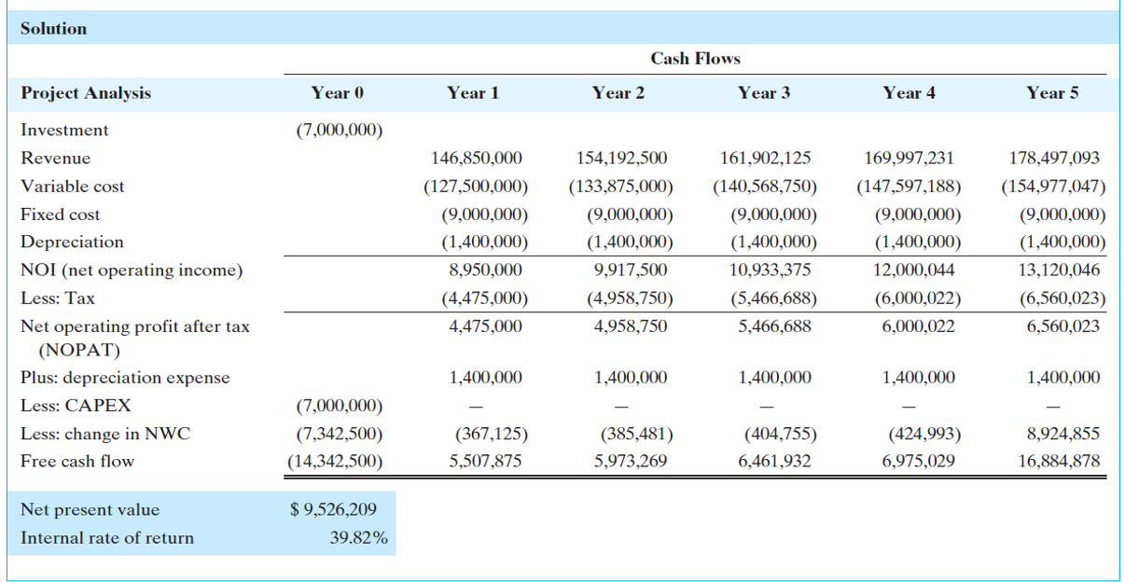
Problem 4 (cont.)

Slide 22

Problem 4 (cont.)
Answer
$NPV=−\$9,413,430$
$NPV=−\$10,261,801$

Slide 23
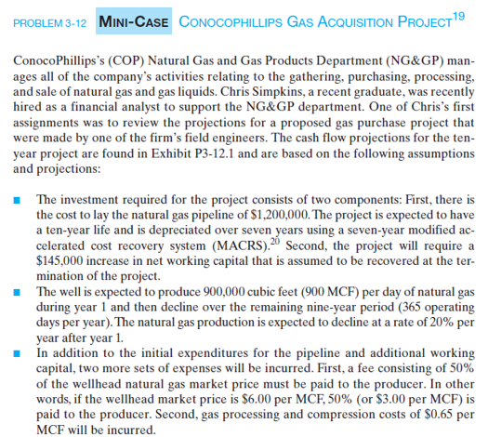
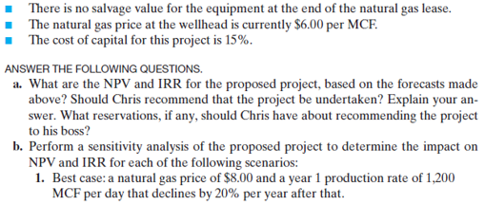
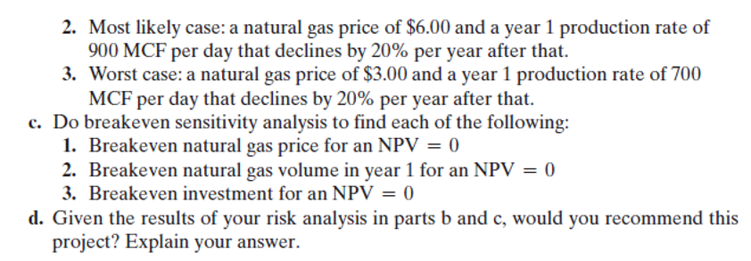
Problem 5

Slide 24
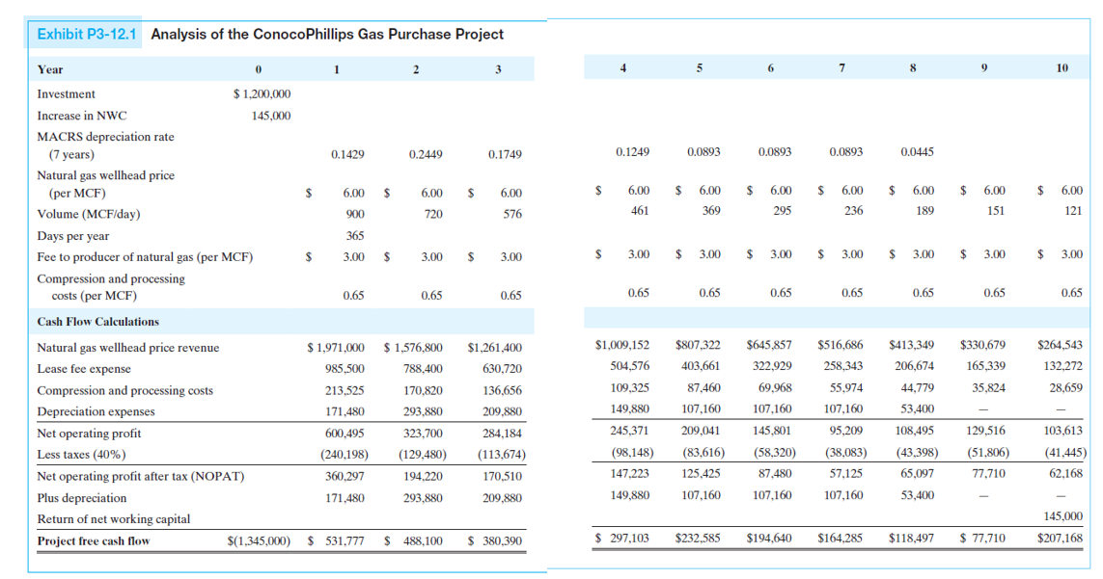
Problem 5 (cont.)

Slide 25
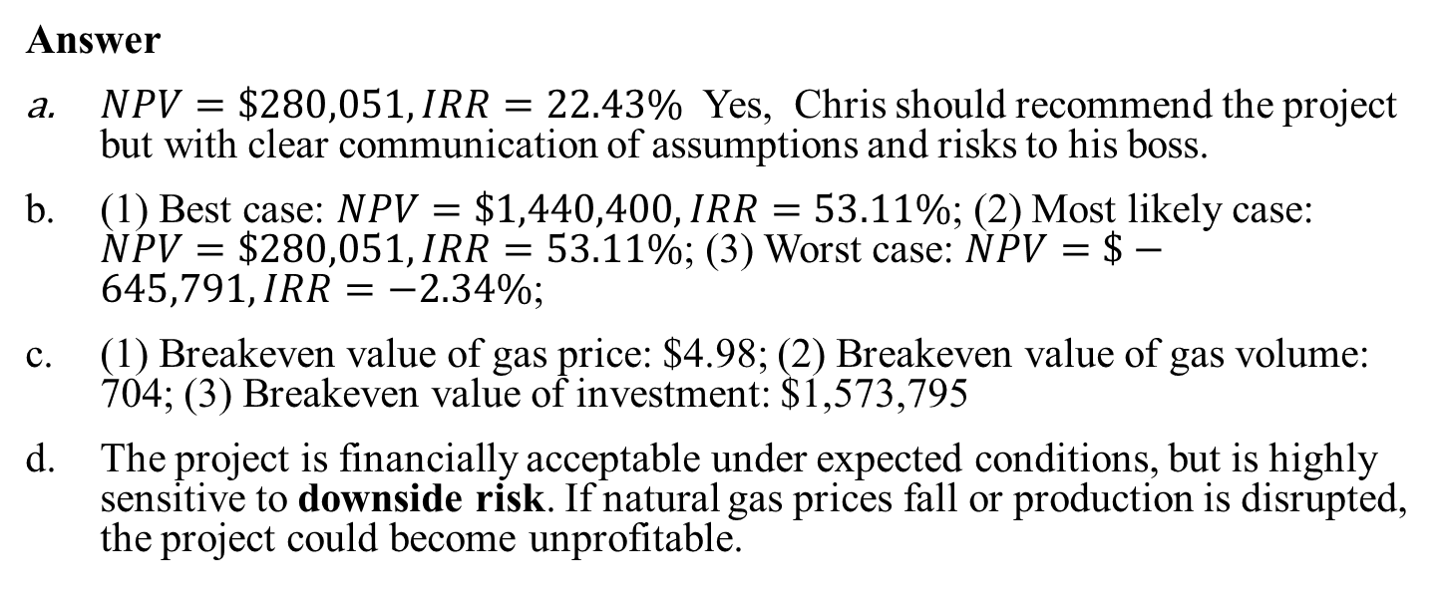
Problem 5 (cont.)
Answer
$NPV=\$280,051, IRR=22.43\%$ Yes, Chris should recommend the project but with clear communication of assumptions and risks to his boss.
(1) Best case: $NPV=\$1,440,400, IRR=53.11\%$; (2) Most likely case: $NPV=\$280,051, IRR=53.11\%$; (3) Worst case: $NPV=\$−645,791, IRR=−2.34\%$;
(1) Breakeven value of gas price: $4.98; (2) Breakeven value of gas volume: 704; (3) Breakeven value of investment: $1,573,795
The project is financially acceptable under expected conditions, but is highly sensitive to downside risk. If natural gas prices fall or production is disrupted, the project could become unprofitable.

Slide 26
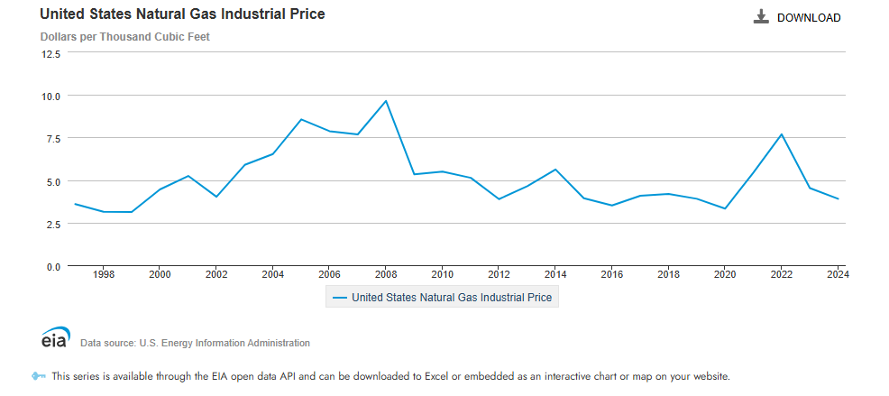
Problem 5 (cont.)
$4.98 per MCF

